Slide 1







Retail: Sales & Customer Analytics
Team Members:
1) Roshini K - (Snowflake Data Engineer)
2) Dharineesh V - (Salesforce Developer)

Slide 2


Agenda:
1) Architecture Diagram
2) Data Model
3) Data Loading
4) Data Quality Check
5) Dashboard

Slide 3
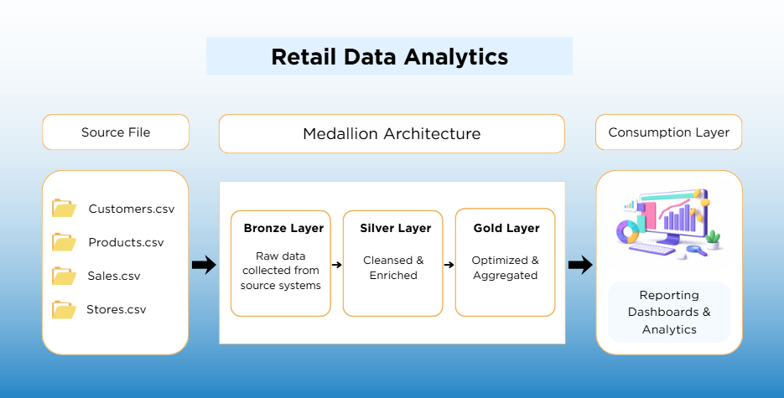

Architecture Diagram
Bronze Layer: In the raw data layer, we upload customer, product, sales, and store flat files.
Silver Layer: In the Silver layer, the data is loaded and transformed by applying trimming and removing duplicates.
Gold Layer: The Gold layer contains aggregated, optimized, and business-ready data to support business analytics and dashboards.

Slide 4
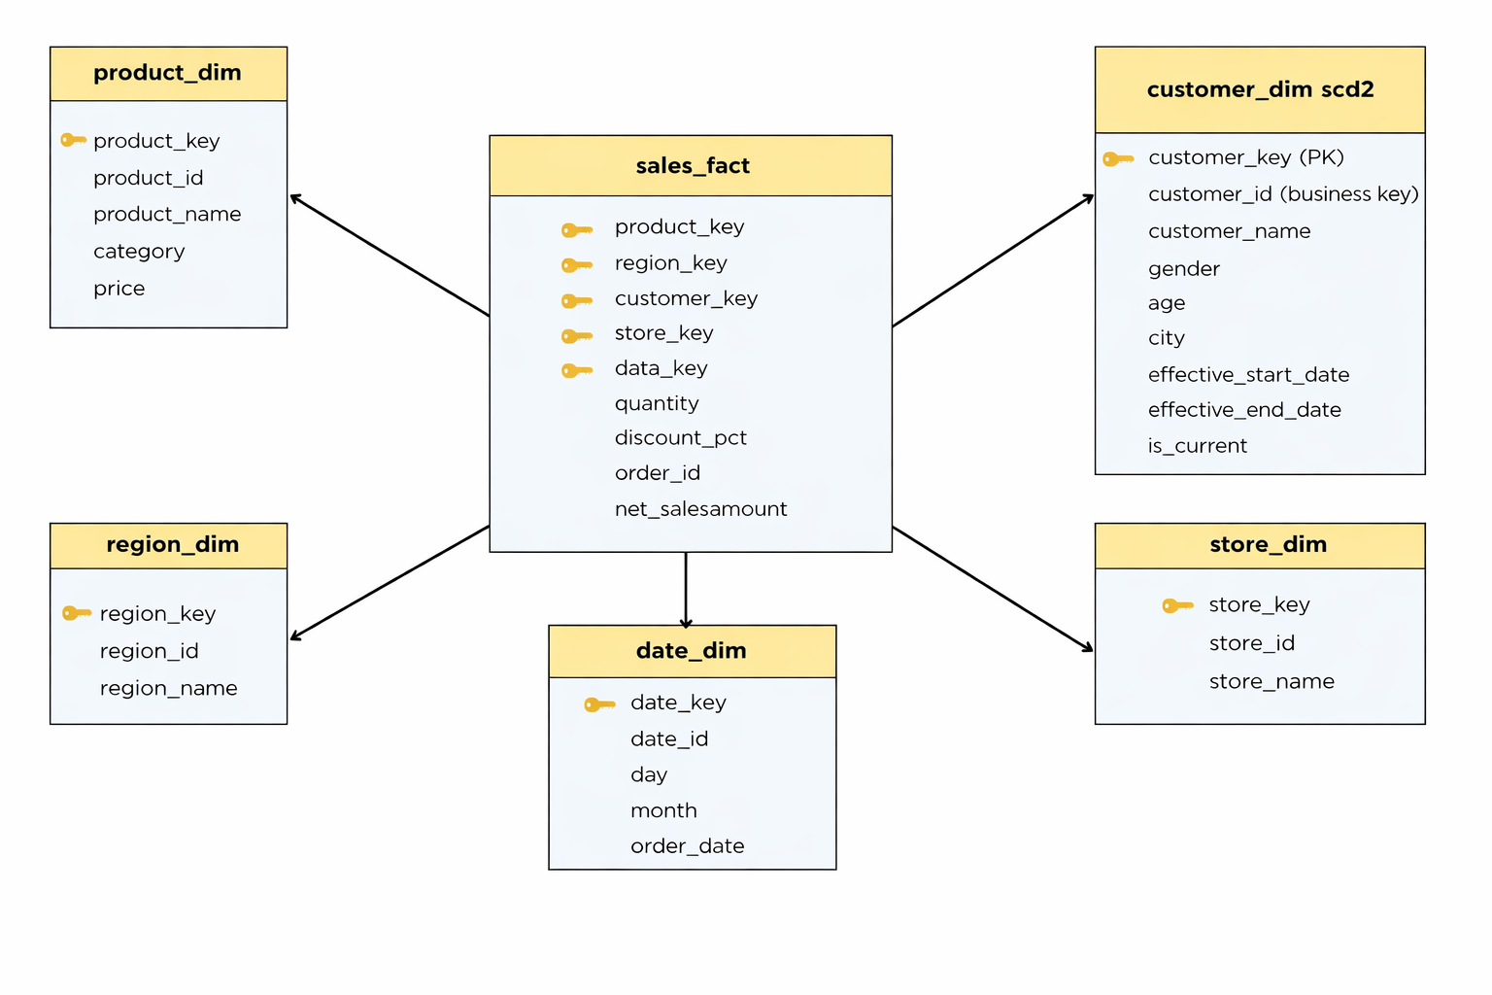
Data Model

Slide 5
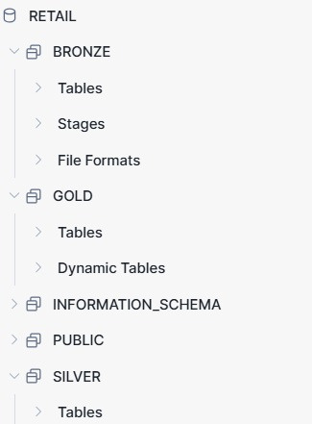
Data Loading
Bronze Layer: Stores raw data loaded directly from source CSV files
Silver Layer: Cleans and transforms data by removing duplicates, handling nulls, and standardizing fields
Gold Layer: Contains business-ready fact & dimension tables and KPI dynamic tables for reporting
Stages & File Formats: Used to upload and read source files
Consumption Layer: Dashboards and reports built using Gold layer data

Slide 6
Data Quality Check
Cleaned and standardized customer, product, sales, and store data using TRIM and COALESCE.
Ensured one unique record per customer and product.
Removed duplicate records using DISTINCT and ROW_NUMBER.
Filtered out null and invalid primary key records.

Slide 7

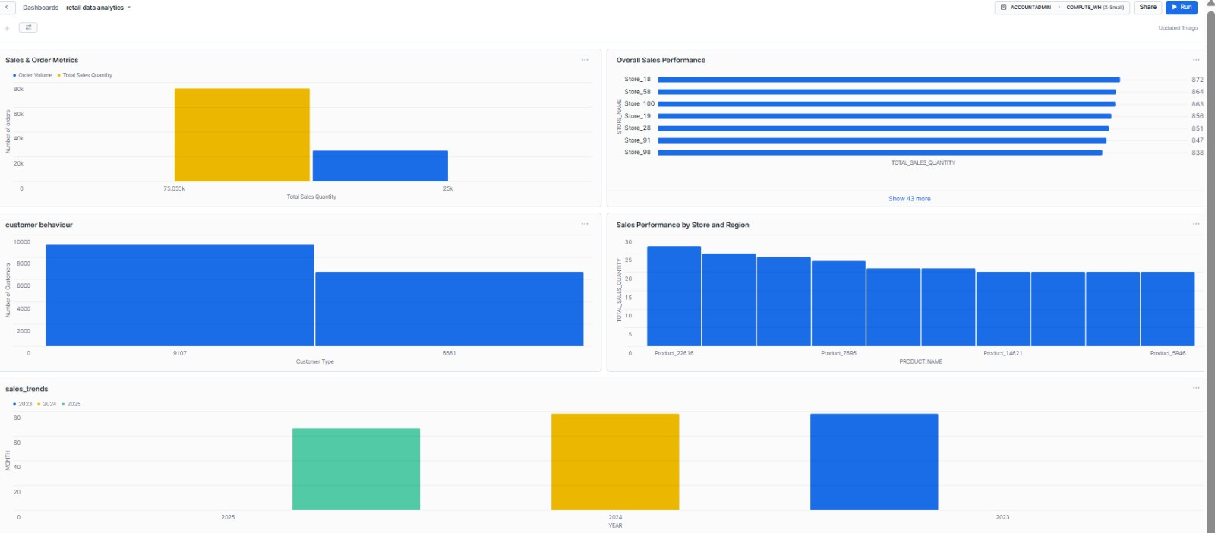
Dashboard

Slide 8
THANK YOU

